Slide 1

MadQL
Internal log
Case ID: 77-322-40LS
Customer : TopShape Sports Center
Obviously fake company by:
Chen Zecharya
Harel Azim
Rani Daas

Slide 2
Project statement ~12.1.2019
The customer had approached our company in order to improve their internal efficiency. We were asked to analyze and build an improved data-base structure for the customer’s systems.
After a short analysis by our experts, it was established that amending the system that the customer was using at the moment would take more resources than implementing a new one altogether. Hence it is to be scrapped.
The customer would deliver 10% of the fee for each met condition in the roadmap, and the rest upon completion.
The total pricing of the project is REDACTED.

Slide 3
Team introduction and Goals ~16.1.2019
In our initial introduction, we’ve met with Mr. Raymond Sawyer, CEO, Mr. Danny Green, CFO and Ms. Rebecca Holt, head of HR.
Reports will be made on a weekly basis on a meeting currently scheduled to Wednesdays at 14:00 at the company HQ.
Mr. Green asked us to focus on monetary usage and to allow them to find holes and ways to improve.
Ms. Holt insisted that customer comfort should be top priority.

Slide 4
Basic inspection ~29.1.2019
On the first two weeks we’ve sent a team to go over the systems currently being used in order to learn what information is being kept, what is not and what does the customer actually need.
While the team had raised some very concerning issues, most of the collected information by the customer was valuable and should still be maintained.

Slide 5
Gathered information:
Members: Members are the main income from the sports club, they can use equipment, sign up to classes or contact an administrator in order to establish a training session.
Manufacturers sell equipment to the sports club. Most manufacturers specialize in one field, although they sell all kinds of equipment. Equipment: Everything that can be used by members in order to assist in their workout. From weights to treadmills to a state of the art Olympic swimming pool. Equipment is maintained by some administrators.

Slide 6
Gathered information(2):
Employees: The employees who work for the sports center are split into three main groups.
Personal Trainers – They provide private training sessions for the members.
Instructors – Instructors aren’t always on site, they teach classes here, but in other places too.
Administrators – Administrators are split into two sub groups by their role.
- The front desk is responsible for connecting between personal trainers and members.
- Repairmen are responsible for taking care of all equipment.

Slide 7
Gathered information(3):
Classes: As there were some issues with the way classes were being held( i.e. delays, changes in location, instructors swaps, etc.) our team suggested to maintain class information in a more sophisticated method.
Scheduled classes are planned in advance, with all the variables scheduled as planned.
An actual class information is put into the system only after the class took place. In it we’ll keep information as to changes in the variables as they may occur.

Slide 8
Entities:
Manufacturers: Manufacturer ID, name, specialty.
Equipment: Serial number, description, working condition
Sale: Sale ID, Manufacturer ID, equipment Serial number, price, purchase date.
Manufacturer audit – To be discussed later.
Members: Member ID, first name, last name, date of birth, member since, monthly fee and deal.
Equipment Usage: Member ID, equipment serial number, used on date, rating

Slide 9
Entities(2):
Employees: ID, first name, last name, salary, working since.
Personal trainers : Specialty.
Administrators: shift time, role.
Instructors: teaches, availability.
Repair Session: Session ID, employee ID, equipment serial number, decommission date, reason, fixed date.
Training session: Session ID, member ID, personal trainer ID, Admin ID, time, date, price.

Slide 10
Entities(3):
Scheduled class: Class ID, taught by(instructor id), day of week, class name, time, duration, location
Actual class: Class ID, Instructor ID, location, start time, end time
Participation in class: Code, class ID, member ID
Seeing tables is boring, but

Slide 11
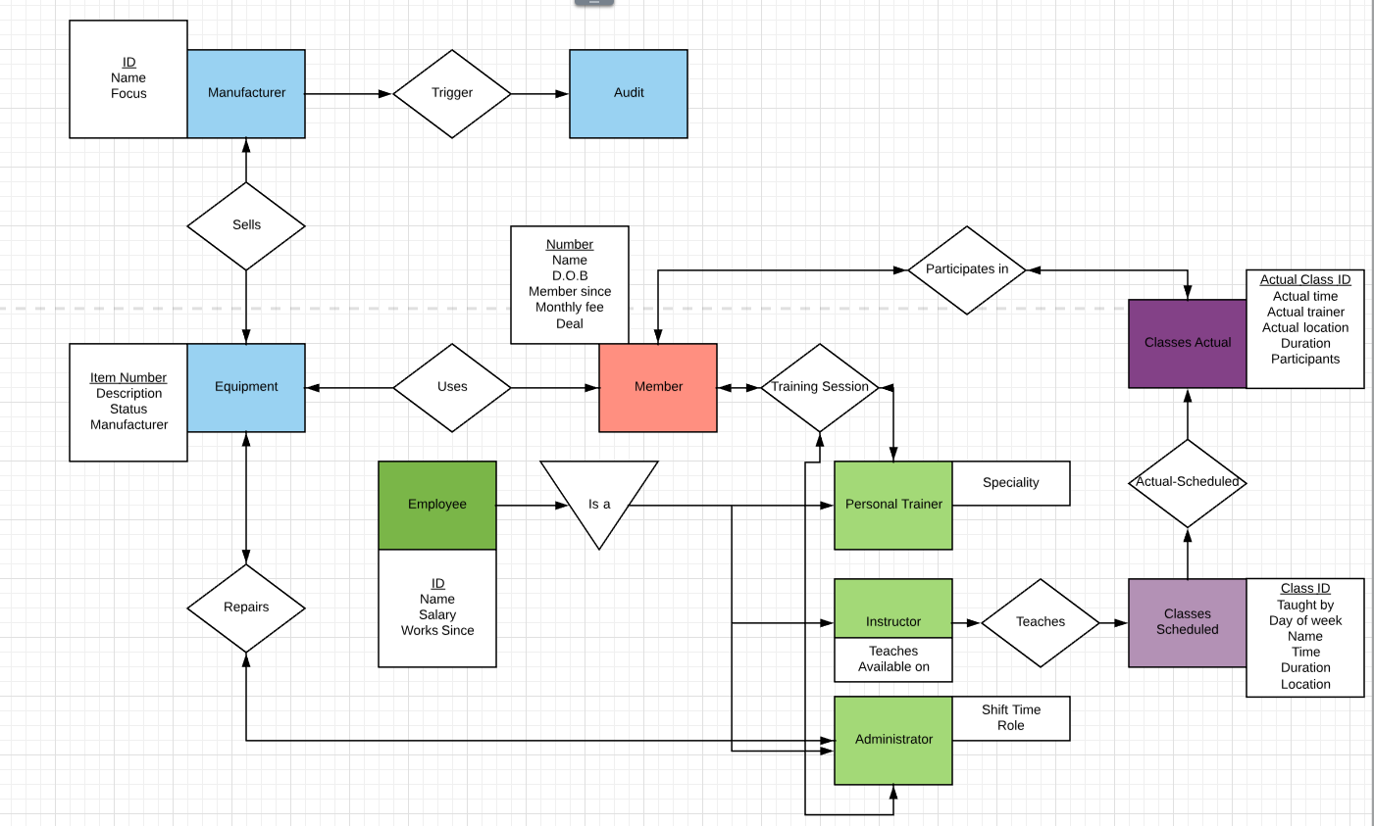
Logical ERD

Slide 12
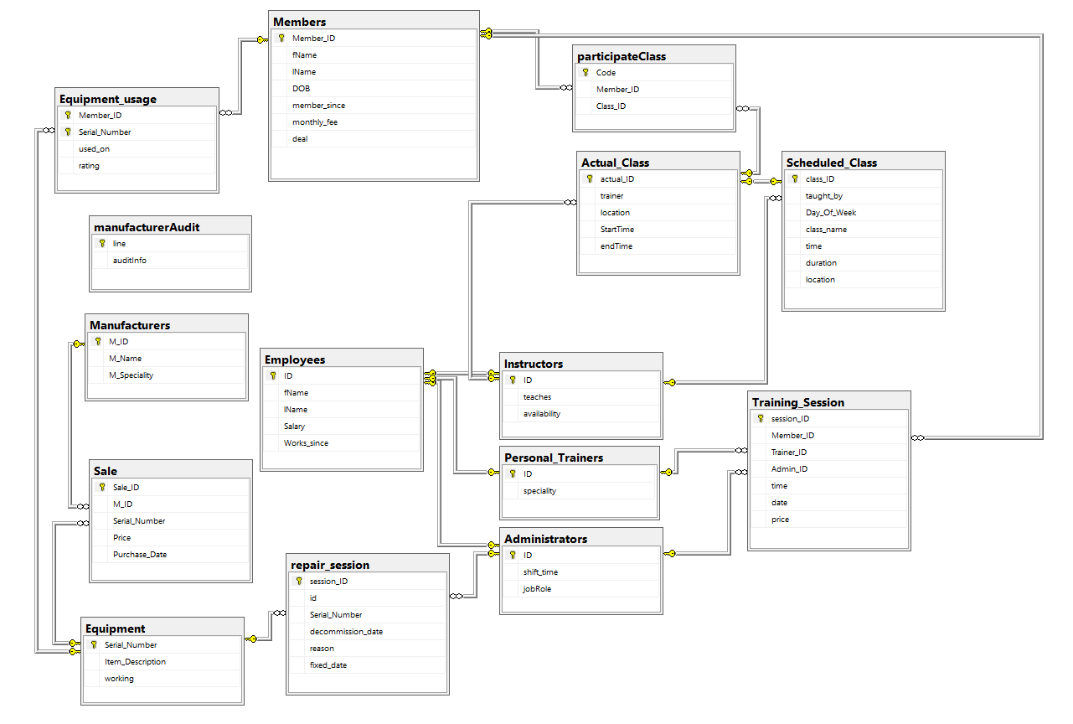
Physical ERD

Slide 13
Private meeting with Mr. Danny Green, CFO on 13.2.2019
In the meeting, Mr. Green raised some concerns about the way manufacturers were being handled. Manufacturers that have changed their names, additions of new manufacturers or ending relations with current manufacturers.
To address this, the team suggested the addition of an Audit table for manufacturers that will maintain records of any change made to a manufacturer.
In order to ensure that the audit will be updated actively, we’ve set a few triggers in the database

Slide 14
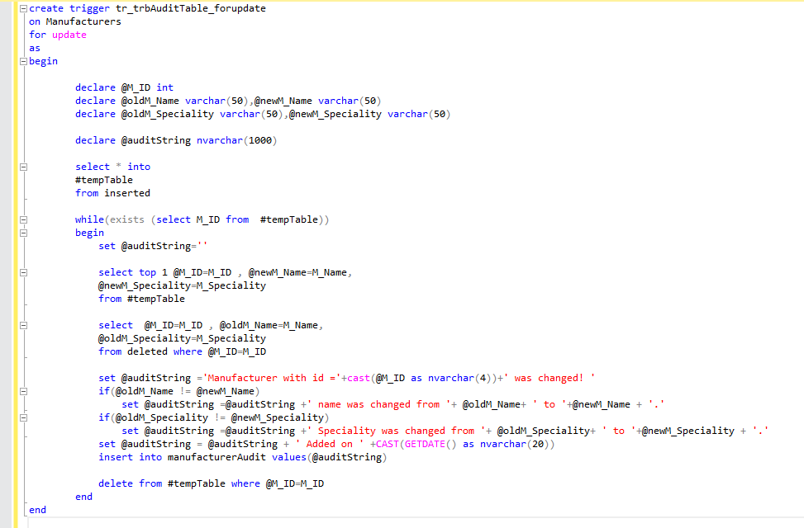
Update manufacturer information

Slide 15
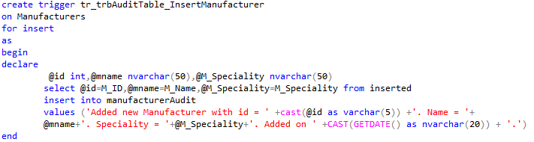
Inserting a new manufacturer information

Slide 16
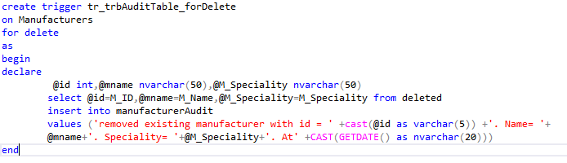
Removing a manufacturer

Slide 17
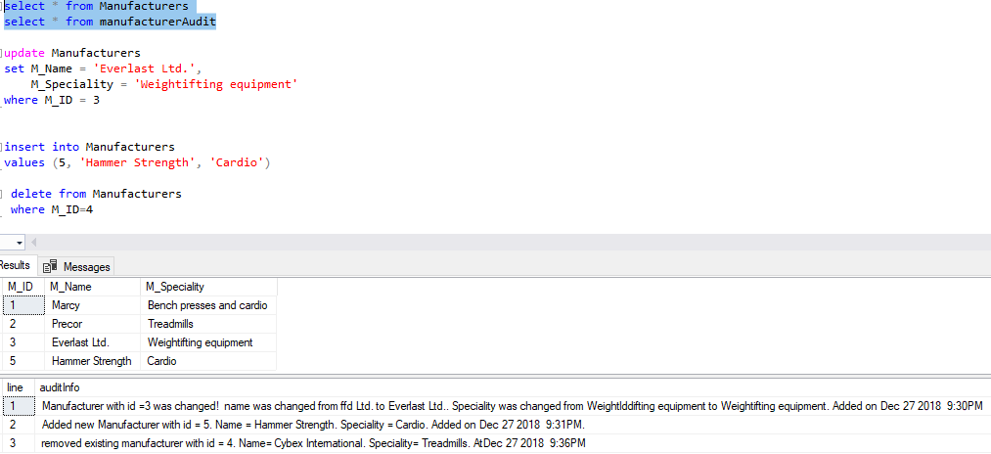
Triggers results

Slide 18
Meeting with management ~27.2.2019
Meeting took place after the initial integration of the database to the customer’s servers.
In the meeting, Mr. Green expressed concerns regarding money usage and equipment maintenance, we’ve established queries to allow the customer to tackle those issues.
In addition, Ms. Holt had asked us to handle integration between the database and the app members use on their mobile.
To tackle those issues, we’ve established alongside with a team from the customer side some queries.

Slide 19


Sample management queries
1: How much do we pay monthly for all of our employees, how many employees are there?
2: What is the most popular location, how many classes are being held there?
3: Who is the most senior employee in the company?

Slide 20
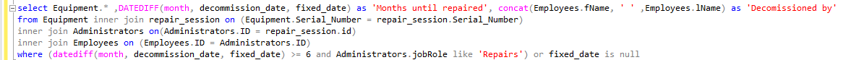
Sample management queries(2)
4: Get a list of all equipment that took at least half a year to repair, and all equipment that is currently broken.
5: What is the most profitable training session?

Slide 21
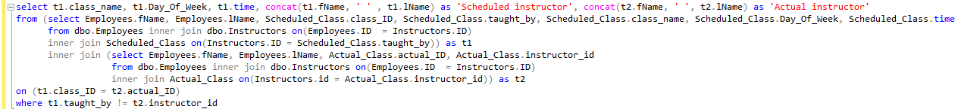
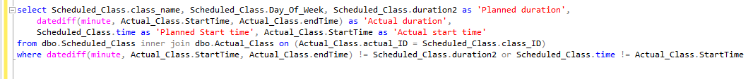
Sample management queries(3)
6: Returns all classes where the instructor was changed
7: Returns classes with classes discrepancies or delays, and shows how long those classes took

Slide 22

Sample member queries: (variable information is redacted)
1: Which equipment is the highest rated?
2: When, what and where is my class?
3: Return a list of all equipment I’ve used and is currently broken

Slide 23
Sample member queries(2):
4: What’s the name of the class and the instructor on the last class of a specific day.
5: How much do I pay for the month? Base fee + training sessions

Slide 24
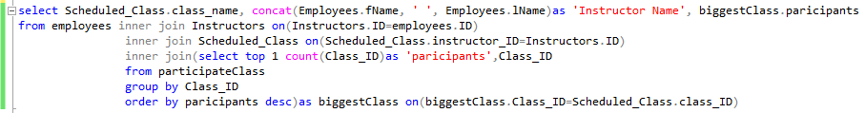
Sample member queries(3):
6: Which class has the most participants, who teaches it?
Bonus: Due to popular demand: What’s the name of the receptionist that works the night shift?

Slide 25




Post initialization, Pre-launch changes ~13.3.2019
In ‘Sale’ table – added a new field – amount. To specify how many items were bought of the type in that sale.
To avoid mistakes, in ‘Actual_Class’ table – replaced column named ‘trainer’ to ‘instructor_id’
To avoid mistakes, in ‘Scheduled_Class’ – replaced ‘taught by’ with ‘instructor_id’
In ‘Equipment’ dropped ‘working’ – not needed.

Slide 26
Report summary ~27.3.2019
Initial database establishment with the customer, TopShape Sports Center began at 12.01.2019 and final meeting will take place on 03.04.2019.
Per the agreement, the team will receive a 10% bonus for completing the project ahead of schedule.
Future changes, updates or upgrades will be discussed individually.
We wish TopShape Sports Center the best of luck in their journey.

Slide 27
Questions?

